Slide 1
“Future Stores” Supermarket Data Mining
Guided By- Submitted By-
Prof. O. P. Vyas Mahesh Dixit(ISE2011026)
Mukesh Jeengar(ISE2011018)
Megha Sharma(ISE2011028)

Slide 2
Contents
Abstract
Problem Domain
Solution Domain
Tools & Technologies used
Use-Case Diagram
Description of the System
Class Diagram

Slide 3
Abstract
Develop a software which is meant for Business Analyst of a “Future Stores” Supermarket. The software will perform Association Rule Mining on a given transactional data of Supermarket and prepares Discounting Policies by preparing Combos.

Slide 4
Problem Domain
The Business Analyst of a Supermarket wants to prepare Discounting policies by preparing various Combo packs to increase the sales of his Supermarket.

Slide 5
Solution Domain
The software will perform Association Rule Mining on given transactional data of sales of Supermarket for preparing various Combos.
The software will implement the Apriori Algorithm to frame association rules.
It will graphically represent frequent itemsets for given value of minimum support and confidence.

Slide 6
Concepts Implemented
Association Rule Mining
Rule measures
Support
Confidence
Apriori Algorithm

Slide 7
Association Rule Mining
A popular and well researched method for discovering association rules (interesting relationships/patterns) among various items in large transactional databases.
For example:
{onions, potatoes} => {burger}
is an association rule.

Slide 8
Rule Measures
Support(X):
Probability of a transaction containing itemset {X} in the given database.
support(A=>B) = P(A U B)
Confidence(X=>Y):
Conditional probability of a transaction containing itemset {X,Y} on itemset {X}.
confidence(A=>B) = P(B|A) = support(A U B) / support(A)

Slide 9
Apriori Algorithm
A classic algorithm that uses “bottom-up” approach for mining frequent itemsets for boolean association rules by operating on a transactional database like collections of items bought by customers.

Slide 10
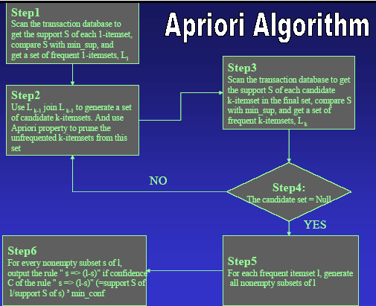

Slide 11
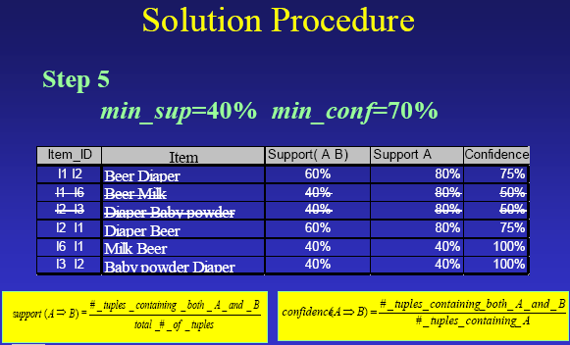
Illustration of Apriori Algorithm
If the minimum support is 50%, then {Shoes, Jacket} is the only 2- itemset that satisfies the minimum support.

Slide 12
Cont…
If the minimum confidence is 50%, then the only two rules generated from this 2-itemset, that have confidence greater than 50%, are:
Shoes ⇒ Jacket Support=50%, Confidence=66%
Jacket ⇒ Shoes Support=50%, Confidence=100%

Slide 13
Tools & Technologies Used
Star UML
Java Beans
Swing

Slide 14
Design
Use Case Diagram :

Slide 15
Description of the whole System
Scenario 1: Mainline Sequence
Analyst: Enter necessary values.
System: Find and display the association rules.
System: Display user interface to enter transaction file, minimum support, and minimum confidence.
Scenario 2: at Step 2 of mainline sequence
System: Displays the message to enter valid transaction file.

Slide 16
Cont…
Scenario 3: at Step 2 of mainline sequence
System: Displays the message that for minimum support or confidence values are not correctly specified. The system displays a prompt to enter valid values.
Scenario 4: at Step 3 of mainline sequence
System: Displays the association rules if any else a message is shown, showing no association rule found.

Slide 17
Class Diagram
UML Class Diagram show the classes of the system, their inter-relationships, and the operations and attributes of the classes. Class diagrams are typically used, although not all at once, to:
Explore domain concepts in the form of a domain model
Analyze requirements in the form of a conceptual/analysis model
Depict the detailed design of object-oriented or object-based software.

Slide 18
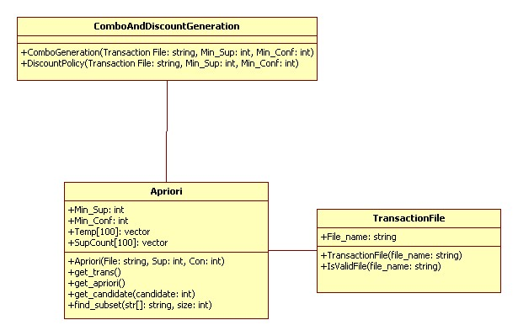
Cont…
Class Diagram :

Slide 19
Queries??

Slide 20
Thank You!

